Slide 1
Instructions for Presentation on Malaria Cases in Children
Please use this slide deck from a TES training in Angola as a template for presenting on the management of malaria cases in children to your in-country TES team.
There are additional instructions in the notes for each slide.

Slide 2


Management of Malaria Cases in Children
THERAPEUTIC EFFICACY STUDY 2017
ZAIRE - BENGUELA - LUNDA SUL
MINISTRY OF HEALTH
NATIONAL DIRECTORATE OF PUBLIC HEALTH
NATIONAL MALARIA CONTROL PROGRAMME

Slide 3
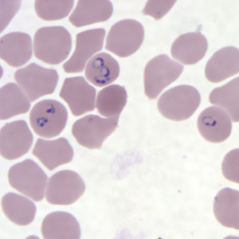
Biology of Malaria
Disease transmitted by the bite of the Anopheles mosquito
Five species of malaria human
Plasmodium falciparum
P. vivax
P. ovale
P. malariae
P. knowlesi

Slide 4
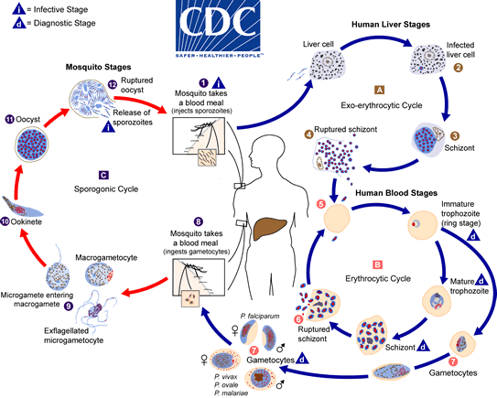
Malaria Life Cycle

Slide 5
Case Management

Slide 6
Suspected Case
YES
NO
Diagnosis
Consider other etiologies
POS
NEG
Treatment
Consider other etiologies

Slide 7
Suspected Case
YES
NO
Diagnosis
Consider other etiologies
POS
NEG
Treatment
Consider other etiologies

Slide 8
Suspected Cases
Symptoms of malaria
Fever
Chills or shaking
Sweat
Headache
Nausea
Diarrhoea
Abdominal pain

Slide 9
Suspected Case
YES
NO
Diagnosis
Consider other etiologies
POS
NEG
Treatment
Consider other etiologies

Slide 10
Diagnosis
Rapid Diagnostic Test (RDT)
Microscopy
PCR (reference laboratories)

Slide 11
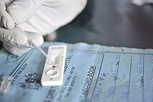
Diagnosis
Rapid Diagnostic Test (RDT)
Antigen detection
Fast (15-20 min)
Easy to implement
No information on parasitemia density
Limited information on the species

Slide 12
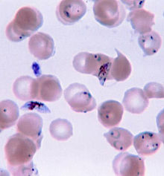
Diagnosis
Microscopy
Research of haematozoa
40 minutes to prepare, colour and read the slide
You need a trained technician
Provides information on parasitemia density (parasites per µL)
Identifies the species and phase in the cycle

Slide 13
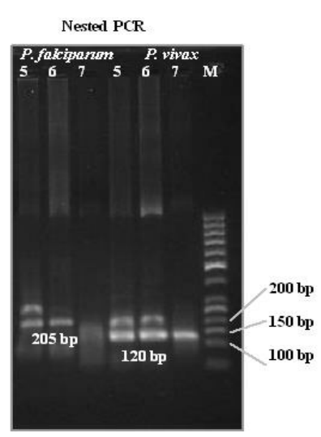
Diagnosis
PCR
Parasite DNA research
Confirmation at national level
Notes:
Polymerase Chain Reaction - PCR

Slide 14
Clinical Suspicion
YES
NO
Diagnosis
Consider other etiologies
POS
NEG
Treatment
Consider other etiologies

Slide 15
Treatment
Two pieces of information needed:
Plasmodium species
Severity:
Uncomplicated / simple malaria
Complicated / severe malaria

Slide 16
Treatment
Plasmodium species
Determined by laboratory test (WHO recommendation)

Slide 17
Treatment
Severity
Determine through clinical signs and laboratory data

Slide 18
Uncomplicated / simple malaria
Malaria without signs of complication / severity

Slide 19
Complicated / severe malaria
Clinical Signs
Changes in consciousness
Prostration
Multiple convulsions
Respiratory distress
Circulatory collapse / shock
Pulmonary edema
Abnormal bleeding
Jaundice
Blood in urine
Laboratory Signs
hyperparasitaemia (>4%)
renal insufficiency (elevated serum creatinine)
severe anaemia (haemoglobin < 5 g/dl)
hypoglycaemia (glucose < 40 mg/dl or < 2.2 mmol/dl)
acidosis (bicarbonate < 15 mmol/l)
hyperlactatemia (lactic acid > 5 mmol/l)

Slide 20
Complicated / severe malaria
Clinical Signs
Changes in consciousness
Prostration
Multiple convulsions
Respiratory distress
Circulatory collapse / shock
Pulmonary edema
Abnormal bleeding
Jaundice
Blood in urine
Laboratory Signs
hyperparasitaemia (>4%)
renal insufficiency (elevated serum creatinine)
severe anaemia (haemoglobin < 5 g/dl)
hypoglycaemia (glucose < 40 mg/dl or < 2.2 mmol/dl)
acidosis (bicarbonate < 15 mmol/l)
hyperlactatemia (lactic acid > 5 mmol/l)

Slide 21
Complicated / severe malaria
Clinical Signs
Changes in consciousness
Prostration
Multiple convulsions
Respiratory distress
Circulatory collapse / shock
Pulmonary edema
Abnormal bleeding
Jaundice
Blood in urine
Laboratory Signs
hyperparasitaemia (>4%)
renal insufficiency (elevated serum creatinine)
severe anaemia (haemoglobin < 5 g/dl)
hypoglycaemia (glucose < 40 mg/dl or < 2.2 mmol/dl)
acidosis (bicarbonate < 15 mmol/l)
hyperlactatemia (lactic acid > 5 mmol/l)

Slide 22
Treatment
Treatment of uncomplicated / simple malaria
Oral antimalarials
ACT (Artemisinin Combination Therapy)
Treatment of complicated / severe malaria
Intravenous or intramuscular antimalarials
Artesunate intravenous, artemether intramuscular, quinine intravenous

Slide 23
ACTs used in (country)
AL: Artemether-lumefantrine
Coartem
2 times a day for 3 days
ASAQ: Artesunate-Amodiaquine
Coarsucam
Once a day for 3 days
DP: Dihydroartemisinin-Piperaquine
Duo-cotecxin
Once a day for 3 days
Notes:
Update this slide to include ACTs approved in your country’s national guidelines

Slide 24
Artesunate-Amodiaquine
Dosage of artesunate amodiaquine (ASAQ)
Weight | Dose
4.5-8.9 kg | 1 tablet 25 mg AS/67.5 mg AQ
9-17.9 kg | 1 tablet 50 mg AS/135 mg AQ
18-35.9 kg | 1 tablet 100 mg AS/270 mg AQ
≥36 kg | 2 tablets of 100 mg AS/270 mg AQ

Slide 25
Artesunate-Amodiaquine
DAY 0
DAY 1
DAY 2
ASAQ
0h
24h
48h

Slide 26
Dihydroartemisinin-Piperaquine
Dosage of dihydroartemisinin-piperaquine (DP)
Weight | Dose
5-9.9 kg | 0.5 tablet per dose
10-19.9 kg | 1 tablet per serving
20-39.9 kg | 2 tablets per dose
≥ 40 kg | 3 tablets per dose
1 tablet contains 40mg dihydroartemisinin and 320 mg piperaquine

Slide 27
Dihydroartemisinin-Piperaquine
DAY 0
DAY 1
DAY 2
DP
0h
24h
48h

Slide 28
Artemether-Lumefantrine
Dosing of artemether-lumefantrine (AL): Administer with food
Weight | Dose
5 -14.9 kg | 1 tablet per serving
15 -24.9 kg | 2 tablets per dose
25 -34.9 kg | 3 tablets per dose
≥35 kg | 4 tablets per dose
1 tablet contains 20mg artemether and 120 mg lumefantrine

Slide 29
Artemether-Lumefantrine
DAY 0
DAY 1
DAY 2
AL
0h
8h
24h
36h
48h
60h

Slide 30
DAY 0
DAY 1
DAY 2
AL
0h
8h
24h
36h
48h
60h
DAY 0
DAY 1
DAY 2
ASAQ
0h
24h
48h
DAY 0
DAY 1
DAY 2
DP
0h
24h
48h

Slide 31
Treatment of Severe Malaria
Intravenous Artesunate
Intramuscular artemether
Intravenous quinine
Notes:
Cross check with national guidelines

